Slide 1
Hyderabad Chapter Report – August’22

Slide 2
MEMEBRSHIP DETAILS
Members | July 2022 | August 2022 | Increase
FCP/CP | 51 | 56 | 5
Patron | 379 | 390 | 11
Total | 430 | 446 | 16

Slide 3
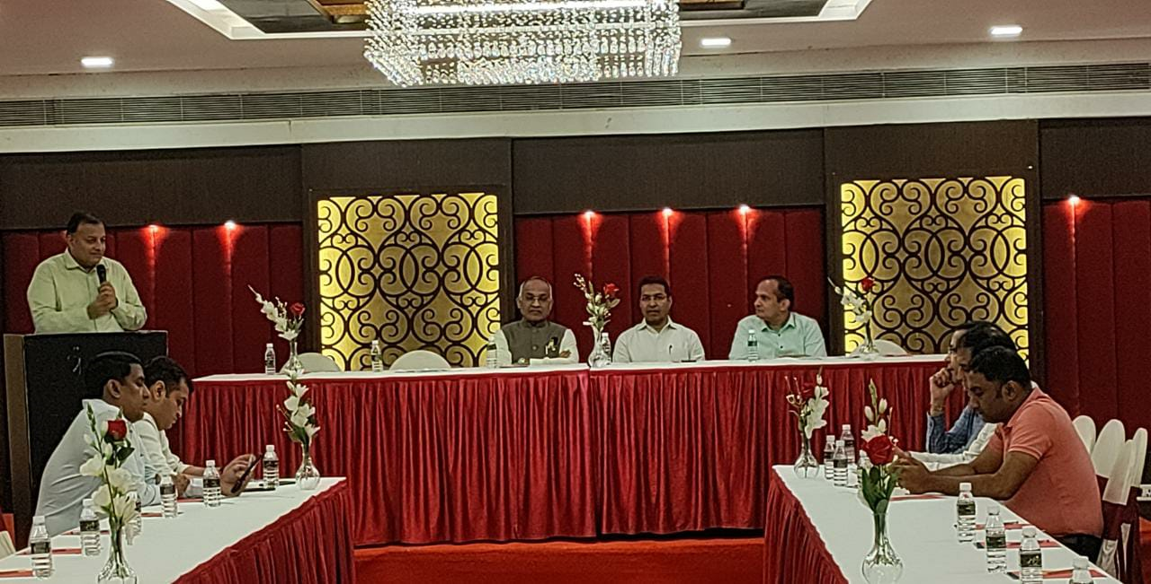
MCM-10
10th MCM meeting held on 22nd August 2022 at Hotel Jalpaan,
Somajiguda , Hyderabad

Slide 4
JBN KOHINOOR

Slide 5
JBN KOHINOOR MEETINGS

Slide 6
The Following Activities are planned for the Month of
September, 2022
Main Chapter:
AGM Meeting
Youth Wing:
Ladies Wing:
JBN
JBN Kohinoor Meeting on 2nd & 4th Saturday

Slide 7
JITO HYDERABAD CHAPTER:
Shri Kushal Kankaria
Chairman
Shri Mahesh Golechha
Chief Secretary

Slide 8
Thank You…

